Slide 1
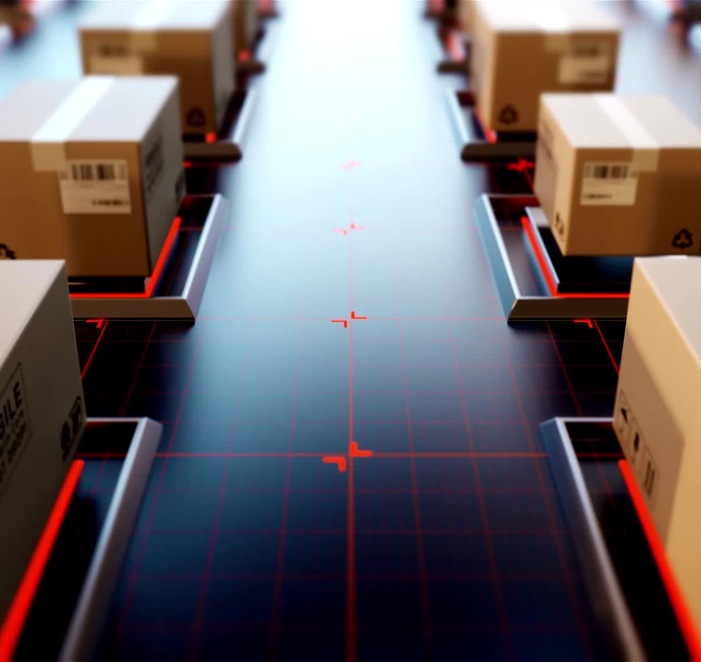
Predicting Delivery Disruptions and Carbon Impact
GROUP 11
Aishwarya Balmoori,
Sampath Sai Srinivas Earli,
Riddhima Reddy,
Tara Canugovi Shriya Kolan

Slide 2
Business Context
Global e-commerce leaders like Amazon, Flipkart, and Target face growing pressure to ensure on-time deliveries.
Customer dissatisfaction and brand damage arise from delayed shipments.
Every 1% increase in late shipments costs the company millions due to churn, refunds, and loyalty loss.
Companies now also face pressure to reduce carbon footprints to meet public sustainability goals.

Slide 3
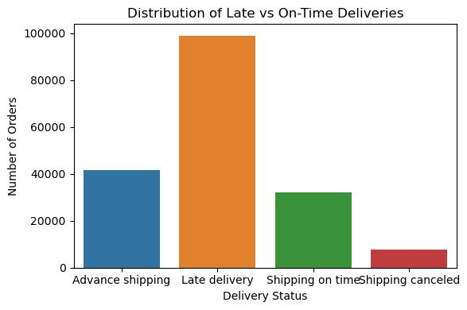
Problem Statement
Lack of early visibility into at-risk deliveries.
No mechanism to predict environmental impact escalation.
Rising costs and missed sustainability goals.
Data Source: Public dataset from Kaggle: Dataco Smart Supply Chain

Slide 4
Project Objective
Build
1
Build a two-part machine learning solution:
Classification Model: Predict whether a shipment will be late (yes/no).
Regression Model: Predict how many days the shipment will be delayed.
Integrate
2
Integrate carbon footprint estimation per shipment.
Enable
3
Enable operations to proactively intervene, optimize resource use, and reduce environmental impact.

Slide 5
Business Question | Null Hypothesis (H₀) | Alternative Hypothesis (H₁) | Methodology (Test, Why, How) | Result | Conclusion
Does order size affect delivery delay? | No difference in mean delay between light and heavy orders. | There is a difference in mean delay between heavy and light orders. | Welch Two-Sample t-test; Two groups (heavy vs light orders); Compare mean delay_days. | p = 0.386 (not significant) | Order size does not significantly affect delay.
Does delivery delay vary across shipping modes? | No difference in mean delay across shipping modes. | At least one shipping mode has a different mean delay. | One-Way ANOVA; More than two shipping modes; Compare mean delay_days across 4 modes. | p < 2e-16 (highly significant) | Shipping mode significantly affects delay; Second Class is the slowest.
Do customer segments experience different late delivery rates? | Late delivery is independent of customer segment. | Late delivery depends on customer segment. | Chi-Square Test of Independence; Both variables are categorical; Test association between is_late and segment. | p = 0.4985 (not significant) | No significant difference in late deliveries across customer segments.
Are late deliveries more common in some U.S. states? | Late delivery rate is independent of order state. | Late delivery rate depends on order state. | Chi-Square Test of Independence; Both variables categorical; Test association between is_late and state. | p < 2.2e-16 (highly significant, warning for sparse data) | Late deliveries vary by state; but data issues (many rare states) exist.
Is there a correlation between discount ratio and delivery delay? | No correlation between discount_ratio and delay_days. | There is a correlation between discount_ratio and delay_days. | Pearson Correlation; Two continuous variables; Test linear correlation between discount and delay. | p = 0.2395 (not significant) | No significant correlation between discount size and delivery delay.
Are high-margin orders shipped faster? | No difference in delay between high-margin and low-margin orders. | High-margin orders are shipped faster (lower delay). | Welch Two-Sample t-test; Two groups (high-margin vs low-margin); Compare mean delay_days. | p = 0.3117 (not significant) | High-margin orders are not shipped faster.

Slide 6

Key Features Selected
Internal Operational Data:
Shipping mode
Order size and quantity
Scheduled and actual shipping dates
Order location (city, region)
External Factors:
Weather conditions during transit
Traffic congestion at major hubs
Carbon Footprint Factors:
Emission rates by shipping method
Estimated CO₂ emissions per
shipment

Slide 7
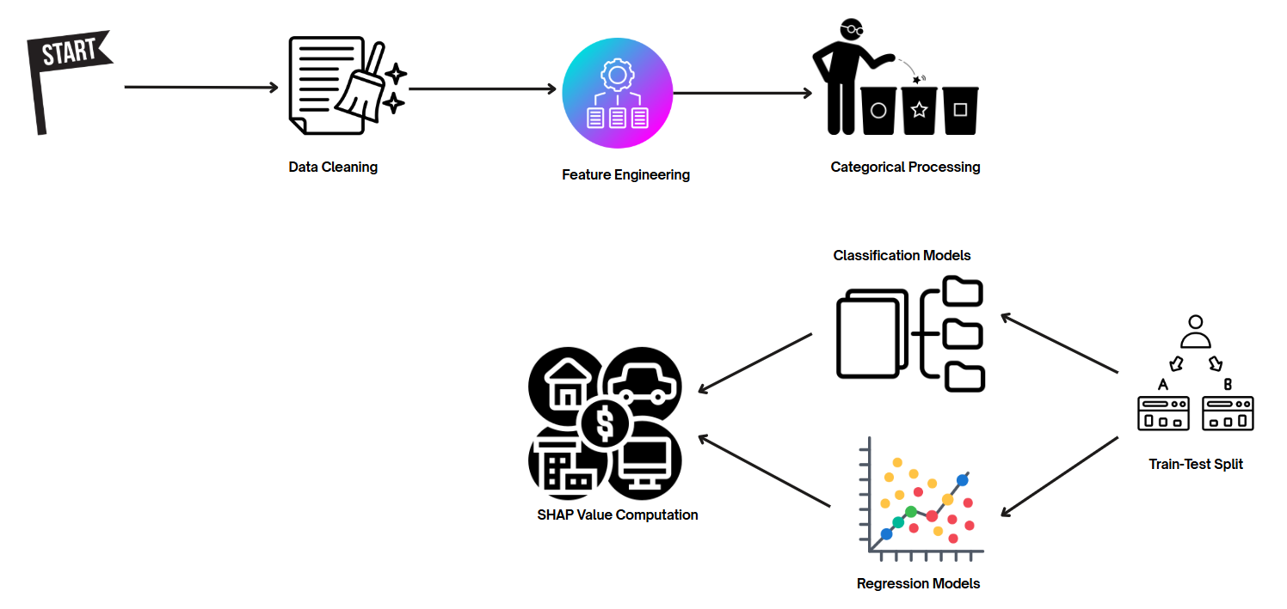
Methodology

Slide 8

Models Used
Classification: Logistic Regression, Random Forest, XGBoost Classifier.
Regression: Linear Regression, Random Forest, XGBoost Regressor.
Model Interpretation: SHAP Values, Feature Importance.

Slide 9
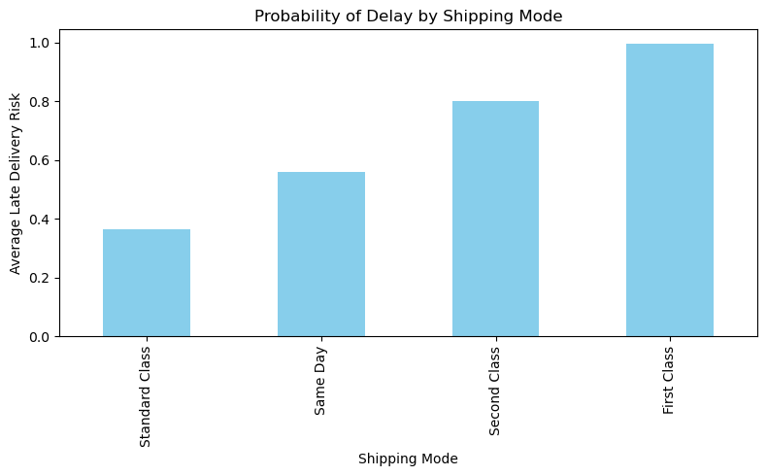
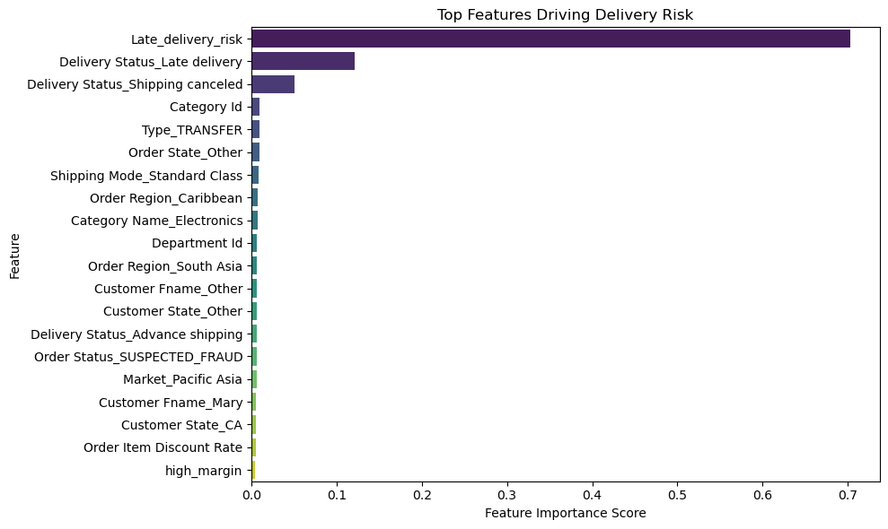
First Model: Late Delivery Classifier
Start with Late Delivery Risk Classification model.
Why start here?
Targets the highest business pain — late shipments.
Prioritizes delayed shipments with highest operational and environmental cost (using carbon footprint).
Supports sustainability and ESG goals through predictive visibility.

Slide 10
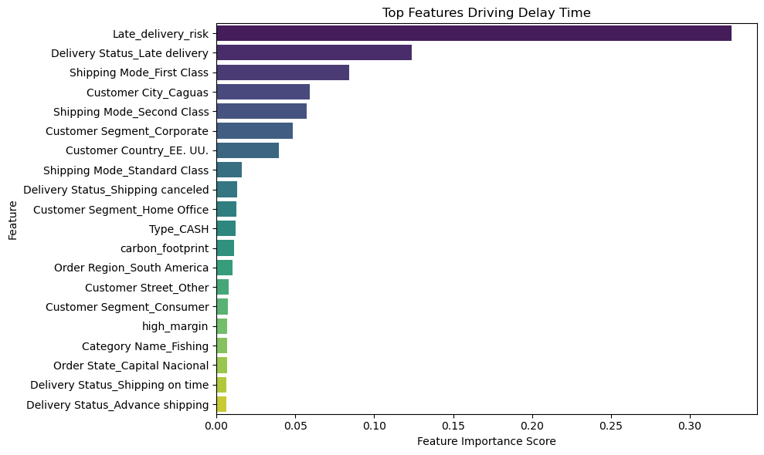
Second Model: Delay Predictor
After classifying late shipments, we estimate how many days a shipment is delayed.

Slide 11
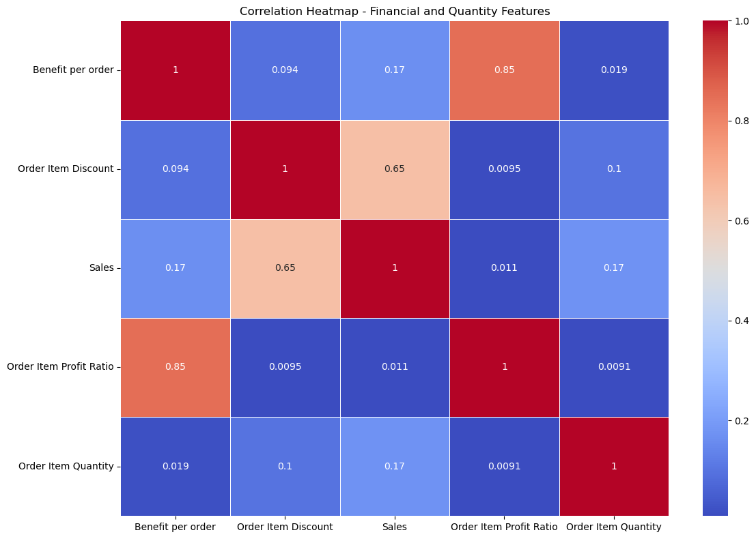

Slide 12
Metrics
XGBoost Classifier
Accuracy: 85.6%
Precision: 86.3%
Recall: 83.1%
AUC: 90.2%X
XGBoost Regressor
MAE: 1.7 days
RMSE: 2.3 days
R^2: 0.68

Slide 13
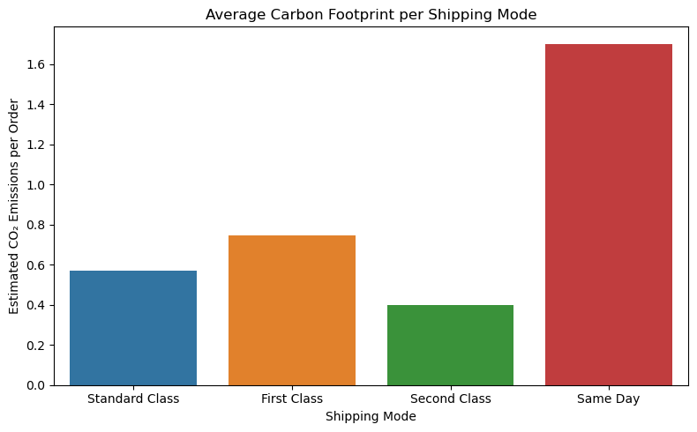
Carbon Footprints Estimation
Same-Day Shipping causes the highest CO₂ emissions.
Standard and Second Class are more eco-friendly.
Optimizing shipping mode = lower costs + lower emissions.

Slide 14
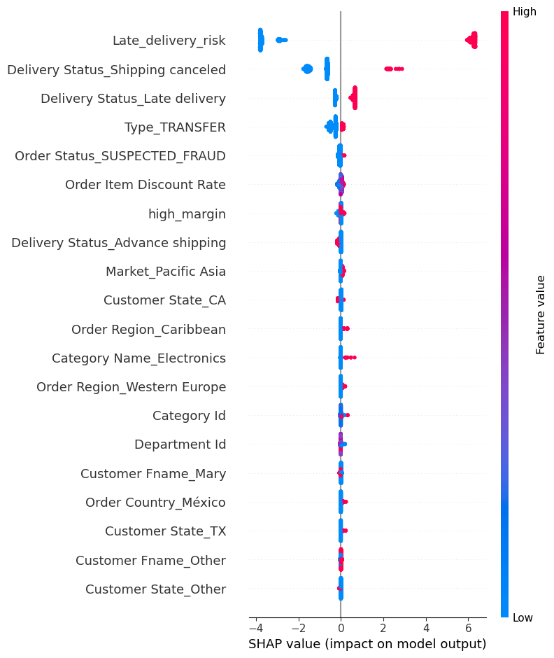

Slide 15
Business & Environmental Impact
1. Estimated 300+ kg CO₂ saved per 1000 orders.
2. Savings range from $10K for small operations to $2M+ annually for large enterprises.
3. Significant ESG reporting improvements.

Slide 16
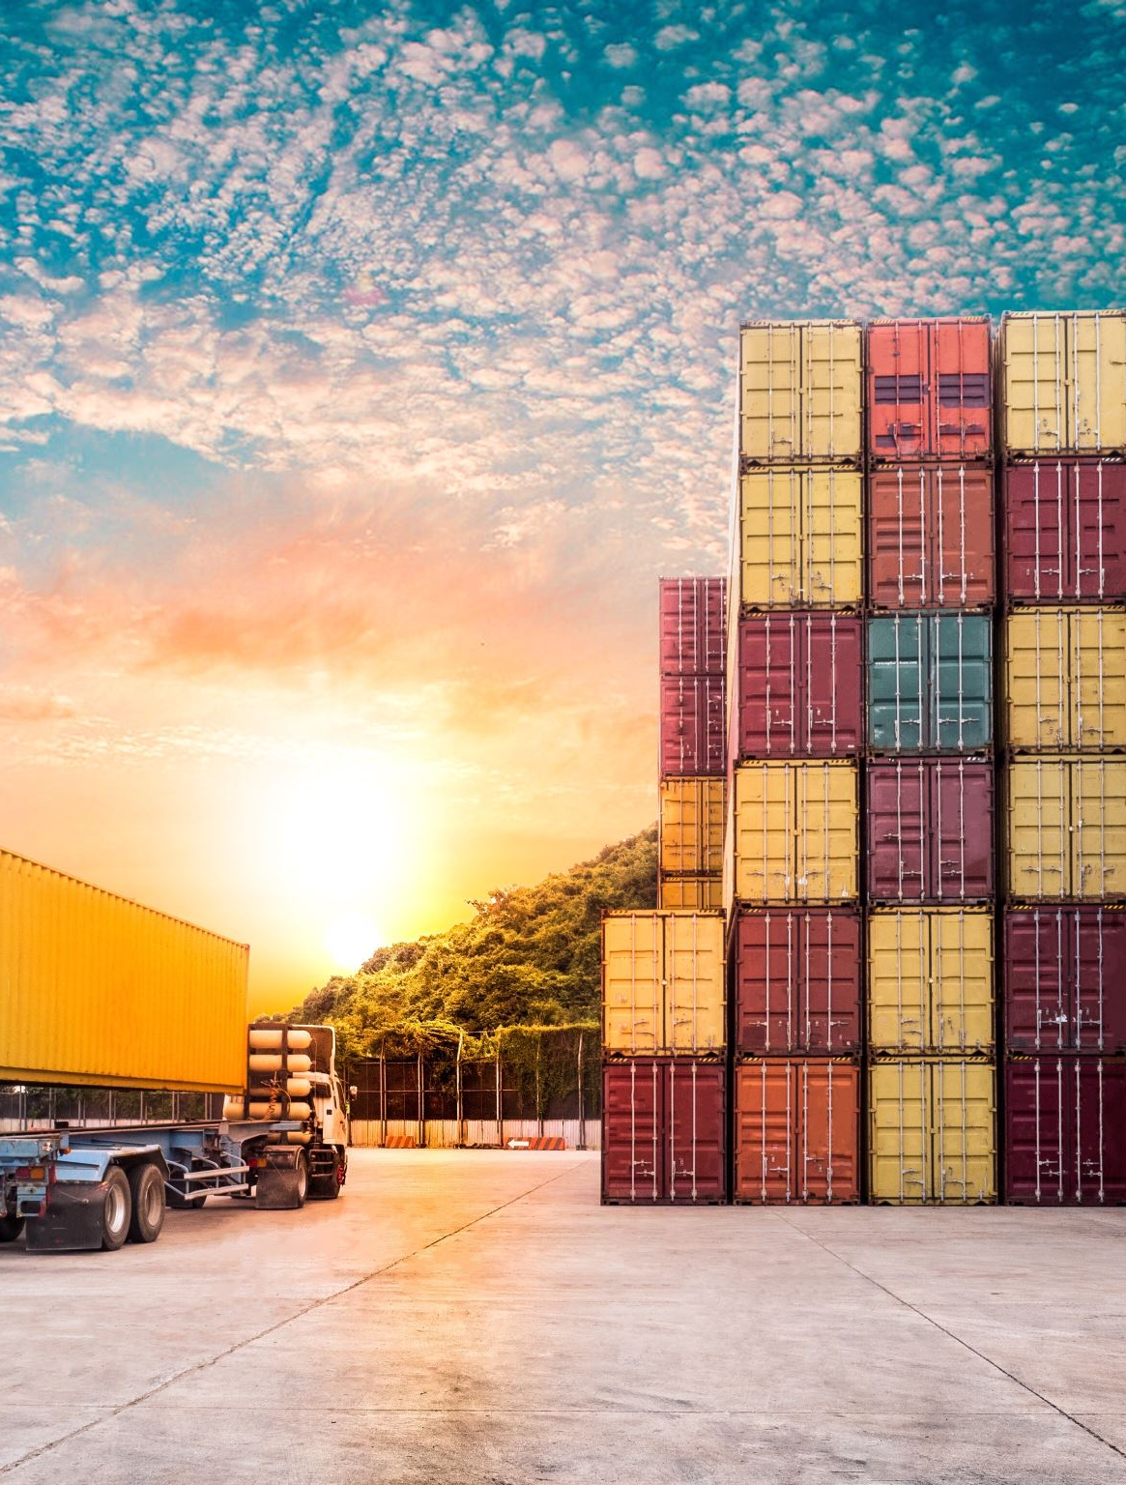
Action Plan After Prediction
Upgrade Shipping for at-risk orders.
Prioritize Warehouse Handling.
Proactive Customer Alerts.
Dynamic Routing Adjustments.
Carbon Optimization: Group Shipments, Offset Emissions.

Slide 17

Key Assumptions
30% extra carbon emissions if delayed (EPA, ICAO).
$10 per late order loss (Amazon, Walmart).
60% mitigation success rate with early intervention (UPS, DHL).

Slide 18
Final Recommendations
Deploy real-time Risk & Carbon Footprint Dashboard.
Integrate Model Insights into Warehouse Management Systems.
Build Feedback Loop for Continuous Model Retraining.
Incorporate Sustainability KPIs into Delivery SLA Metrics.

Slide 19
Conclusions
Predict disruptions before they impact customers.
Reduce operational costs and refund liabilities
Improve carbon footprint, enhancing brand sustainability leadership.

Slide 20

THANK YOU

